Slide 1
REVIEW OF THE COURSE
The series of titles of the presentations given in class provide a good outline of the topics covered during this semester.
In the following slides we provide “snapshots” of the list and we will identify with a those topics that require special attention by the student in preparation for next semester (and for the final examination)
Here is the series of slides:

Slide 2
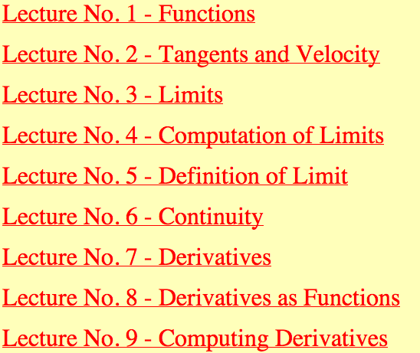
First snapshot: ( = important)

Slide 3
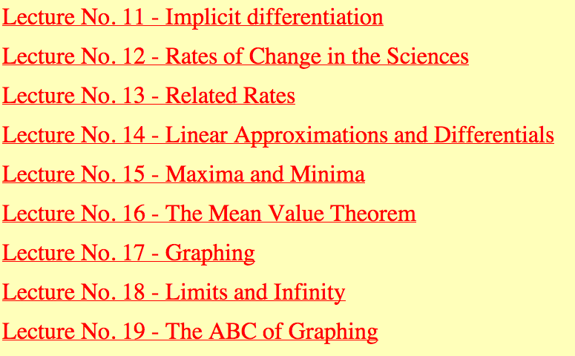
Second snapshot (all important)

Slide 4
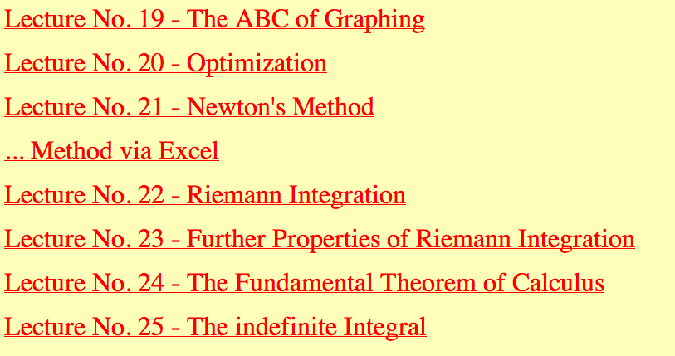
Third snapshot:
The FTC is extremely important, but requires no review.

Slide 5
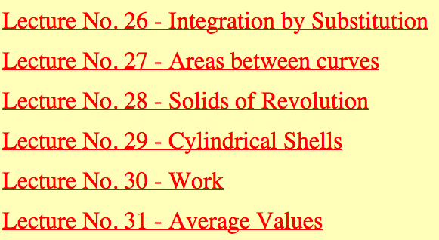
Fourth (and final) snapshot: (all important)
This last presentation is not online as of this writing. It will be by Wednesday night.

Slide 6
Dear All,
I hope I have given you a useful, fruitful and happy semester.
You have given me one of my most joyous semesters, maybe because it is among my few remaining ones teaching, but mostly because
you are one of the nicest, friendliest, most well behaved group of students I have been privileged to teach at Notre Dame. Come Monday afternoon
some of you will hate my guts, but remember
I truly love you all, like a grandfather or older uncle.
Say hello to me when you see me next semester.
Also, after Friday December 17 keep in mind that

Slide 7
You made it through freshman year at
Notre Dame !
Rejoice, be glad, and
Have the merriest of Christmases,
the most fantastic New Year
The most successful 2012 !

